Slide 1
Exploratory Seismic Data Analysis in the Field
Colton Kohnke
Advisor: Dave Hale
Colorado School of Mines
October 7, 2013

Slide 2
The Problem
Only in the field for a short time
Most of time is spent in the office processing
If survey geometry/parameters need to change, want to make the change sooner rather than later.
Want a way to efficiently explore survey geometry in an interactive way.

Slide 3
The Project - JAVA Program
Store/Compute survey geometry
Flags from handheld GPS/iPhone
Compute and display source/receiver locations for each FFID
Use locations to lookup UTM Coordinates and use USGS digital elevation (get x, y, z)
Store information in a spreadsheet (CSV, or other)

Slide 4
The Project - JAVA Program
Display Survey Geometry
Plot source/receiver midpoint in map view
Select points using marque type tool and draw the seismic “line” through selected points
Plot elevation profile along this line
Use a slider to show points for each FFID
Provides graphical history of seismic survey
Will help catch mistakes

Slide 5
The Project - JAVA Program
Interactively display seismograms
Convert SEGD files to IEEE
Display by FFID
Display by midpoint within a defined region
Display by offsets
Controls for
Gain
Amplitude balancing
Zoom and scroll (provided by Mines JTK)

Slide 6
The Project - JAVA Program
Simple processing
Surface wave attenuation
NMO Correction
Integration with SU as a backend?
Might cause compatibility problems

Slide 7
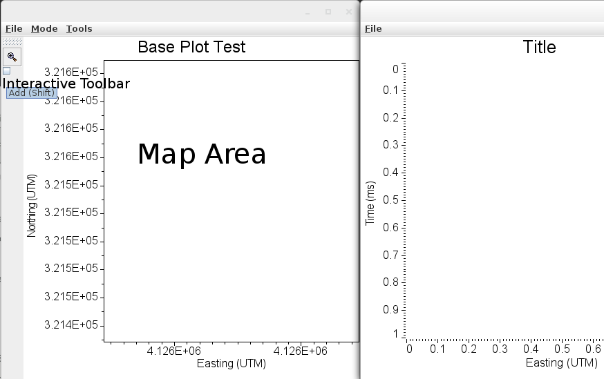
x
x
x
o
x
x
o
x
o
o
o

Slide 8
Questions

